Slide 1
This is a template. You can input anything or modify anything.

Slide 2
Impact of COVID-19 on Mental Health in United States
Group D1: Jie Feng, Jungkyu Kim, Riley Williamson, Rodney Davemann,Veera Supraja Koppisetty, Felix Ogbodu
Instructor: Thomas Raczkowski
TA: Sumit Malik
Date: 05/01/2021

Slide 3
Introduction
Background:
Covid-19 pandemic
Mental health issue
Questions:
Has COVID_19 affected the mental health of Americans?
Are areas high COVID-19 deaths more impacted by mental health issues?
Do areas with low COVID-19 rates have lower rates of mental health issues?
How has Georgia been impacted?
By Veera Supraja Koppisetty

Slide 4
Data importation and merging
Datasets:
CDC: Indicators_of_Anxiety_or_Depression_Based_on_Reported_Frequency_of_Symptoms_During_Last_7_Days(also called Anxiety_data)
CDC(?):
us_states
Merging:
………
By Veera Supraja Koppisetty

Slide 5
Data cleaning
By Jungkyu Kim

Slide 6
Data analysis
By Rodney Davemann

Slide 7
Data analysis Question: How has Georgia been impacted?
#get georgia data
georgia_data=merged_data.loc[merged_data["state"]=="Georgia"]
#display georgia data
display(georgia_data)
#group georgia data by date
georgia_data_group_by_date=georgia_data.groupby(["date"],sort=False)
#get the mean
georgia_data_group_by_date_mean=georgia_data_group_by_date.mean()
By Jie Feng

Slide 8
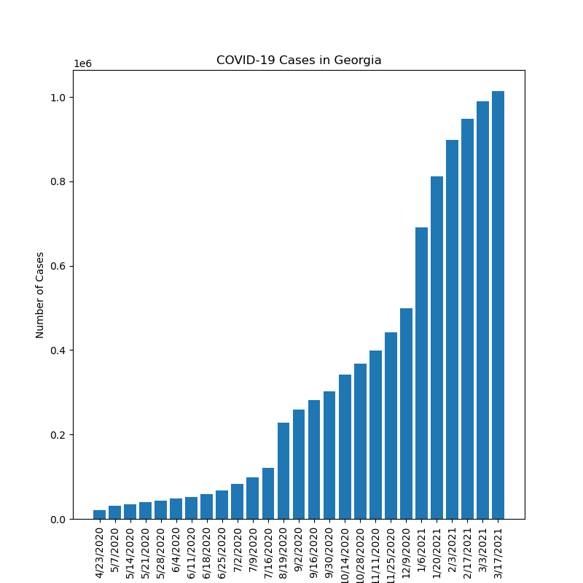
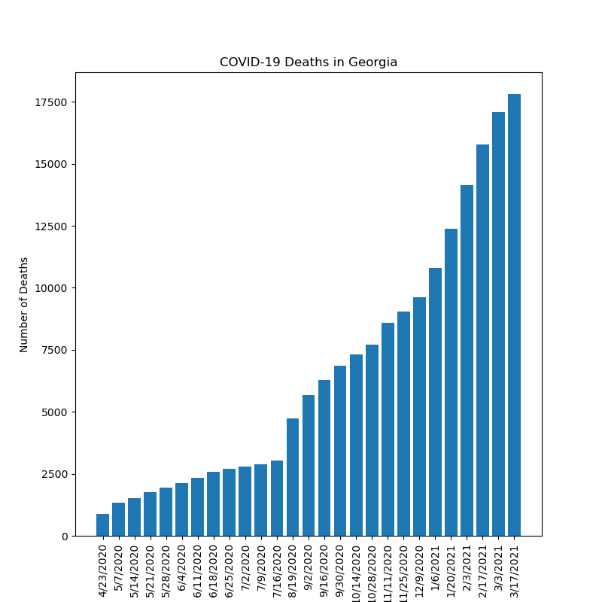
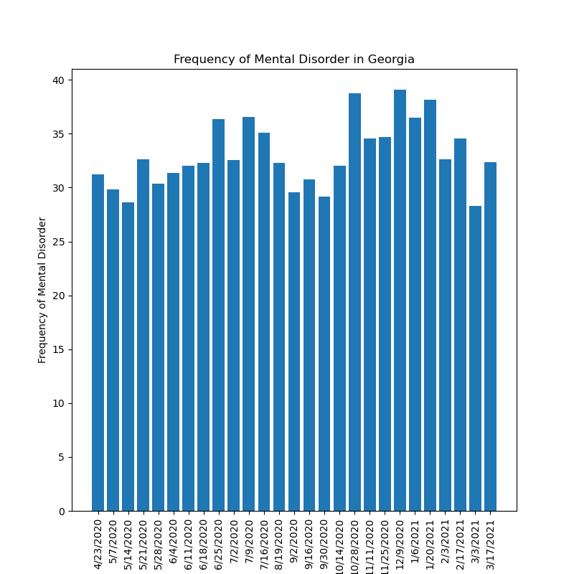
Data analysis Question: How has Georgia been impacted?
By Jie Feng

Slide 9
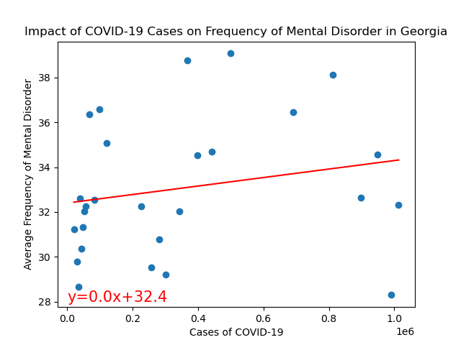
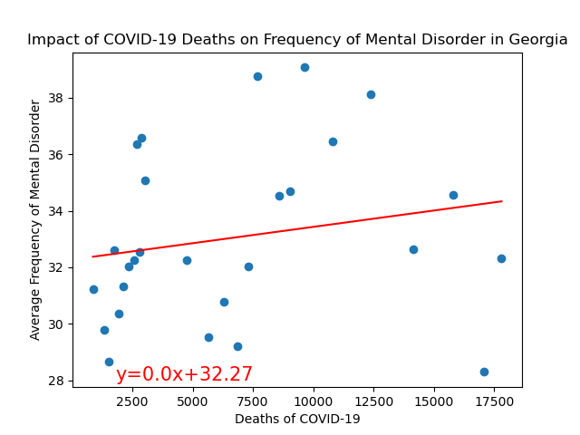
Data analysis Question: How has Georgia been impacted?
The r value is 0.04.
The r value is 0.04.
By Jie Feng

Slide 10
Graphing
By Felix Ogbodu

Slide 11
Graphing
By Jungkyu Kim

Slide 12
Summary statistics
By Riley Williamson

Slide 13
P-test
By Riley Williamson

Slide 14
Conclusion
By Veera Supraja Koppisetty

